Slide 1
Food Price Changes
Over Time in the United States
Stat 184 · Work in Progress Presentation
Shaan Patel, Tammar Reza, & Logan Howard
Notes:
SHAAN SPEAKS: Hi everyone, we are Shaan Patel, Tammar Reza, and Logan Howard. Our project is about how food prices in the United States have changed over time. Today we will share what we are exploring, the data we plan to use, one early idea we have, one challenge we have faced, and our next steps. This is still a work in progress, so we will also talk about what comes next.

Slide 2
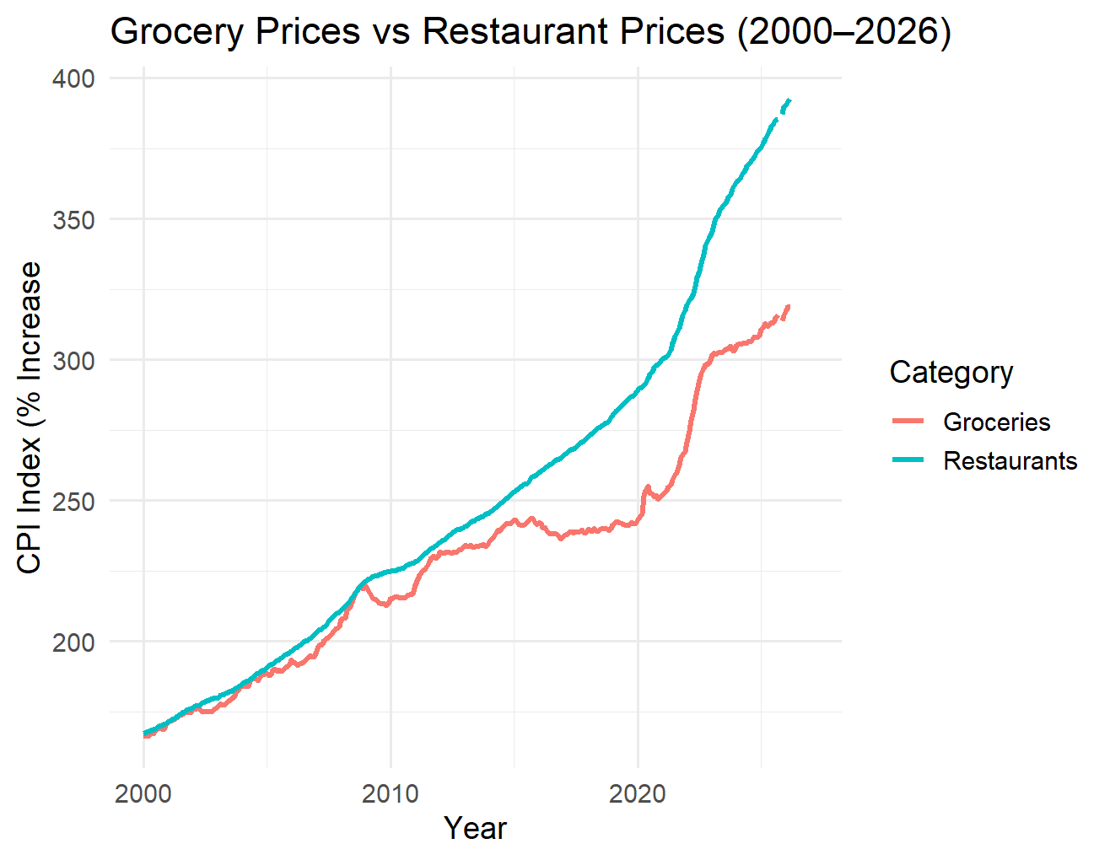
What We Are Exploring
2
OUR TOPIC
How food prices in the U.S. have changed over time
Comparing food at home (groceries) vs. food away from home (restaurants)
Major food categories: fruits & vegetables, meat, dairy, bakery
MAIN QUESTIONS
Which food categories increased the most?
Did grocery and restaurant prices rise at different rates?
Were there years when prices increased especially fast?
Notes:
SHAAN SPEAKS: Our project looks at how food prices in the U.S. have changed over time. We are mainly comparing groceries with restaurant prices. We also want to look at major food categories to see which ones changed the most. Some of our main questions are which category increased the most, whether grocery and restaurant prices moved differently, and whether there were certain years when prices rose much faster. Grocery prices and restaurant prices do not follow the exact same pattern, so we want to study those differences more closely.

Slide 3
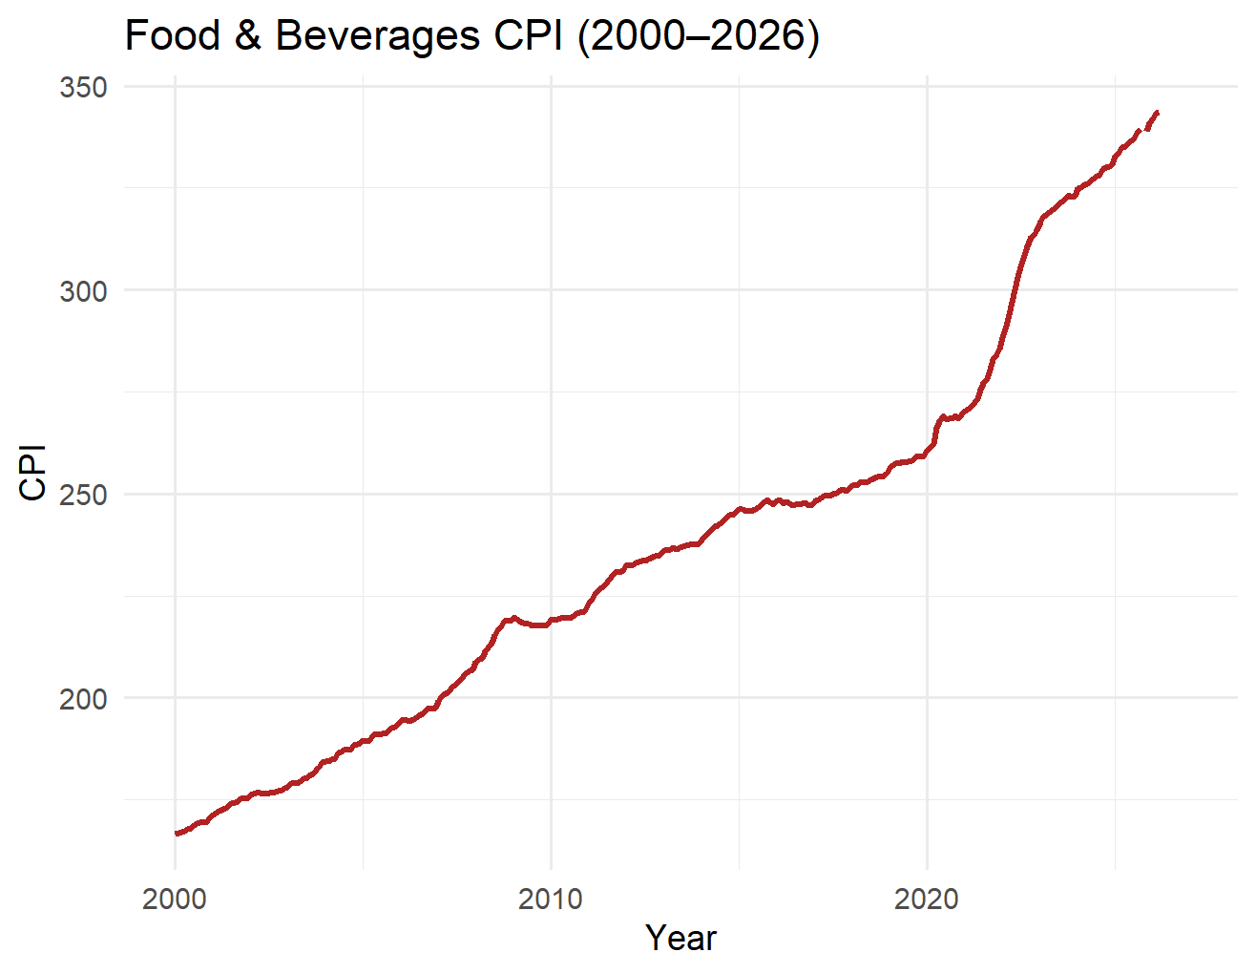
Data Sources & Why This Topic
3
DATA SOURCES
Bureau of Labor Statistics(BLS) Consumer Price Index (CPI)
WHY WE CHOSE THIS TOPIC
Food prices affect everyone
Easy to connect to real life
The data has clear trends to explore
Works well for graphs, tables, and comparisons
It gives us enough detail to make strong graphs and comparisons
Notes:
LOGAN SPEAKS: We plan to use public data from three sources: the Bureau of Labor Statistics Consumer Price Index, FRED from the Federal Reserve, and the USDA Economic Research Service. We chose this topic because food prices affect everyone, so it is easy to connect to everyday life. It also gives us strong trends to explore with graphs and tables, and it is great practice for working with real data in R.

Slide 4
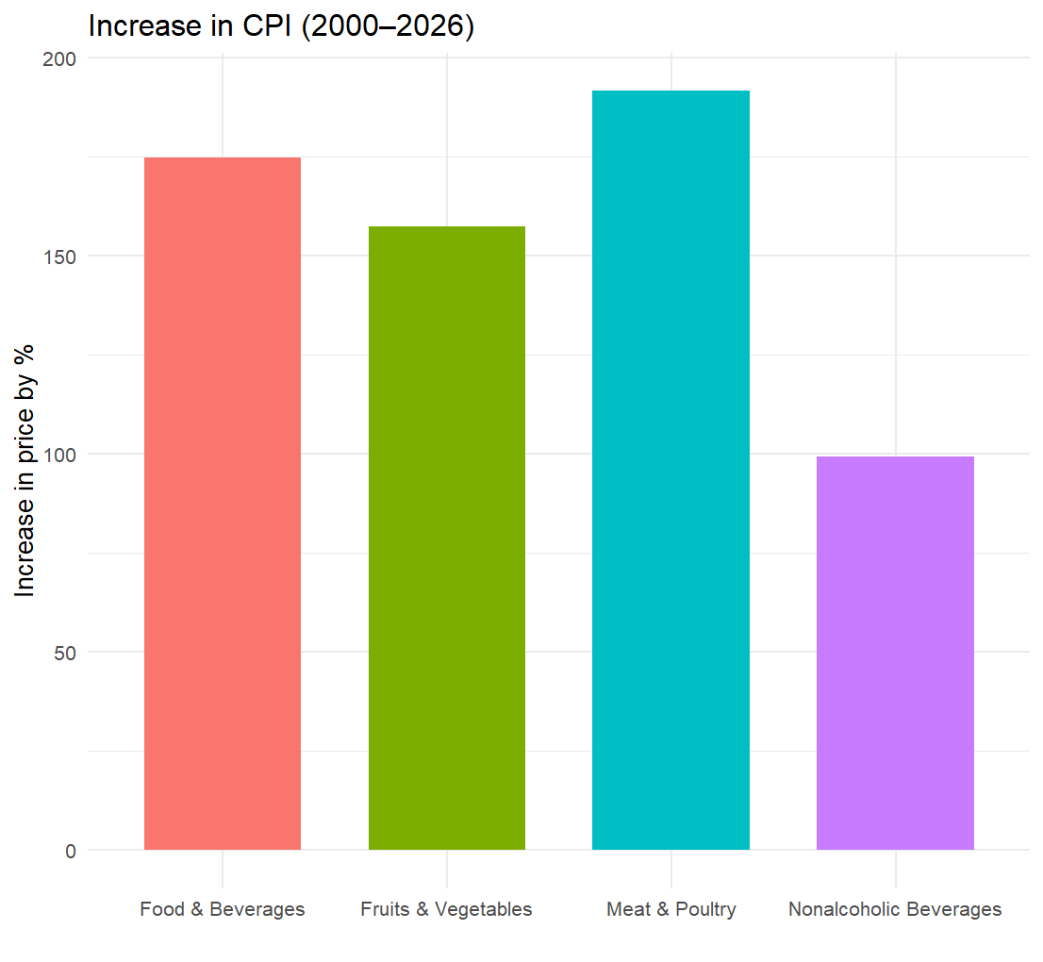
Early Idea & Challenge
4
💡 Early Idea
Grocery and restaurant prices may follow different patterns over time
Some food categories may have increased faster than others
Prices may have risen more sharply in recent years
⚠️ Challenges
Choosing which categories to focus on
Making sure the data matches across sources
Organizing the data so comparisons are clear
Missing or incomplete data due to government shutdowns
Notes:
TAMMAR SPEAKS: One early idea we have is that grocery prices and restaurant prices may not move the same way over time. We also think some food categories increased faster than others, and prices probably went up more sharply in recent years. One challenge has been deciding which categories and sources to focus on, while also making sure the data is organized in a way that makes comparisons easy.

Slide 5
5
Thank You!
Questions?

